Slide 1
Campaigning
In the world of Student Politics

Slide 2
The Rules
Do NOT:
Campaign in academic spaces
Ask staff to endorse you
Sabotage others
Buy a plane
Sit up all night worrying about other candidates having more Facebook likes
Rely on just one form of campaigning

Slide 3
Do:
Get your name out there
Ask people for help
Take breaks, eat and sleep
Critically campaign
Be a decent human being
Be creative and proactive
Talk to people

Slide 4
Timing is everything

Slide 5
Good old fashion print

Slide 6
Social Media
Facebook
Page > Group Always
Use it to keep people updated
Keep up a 2 way conversation
Tag people
Twitter
Use your own
#DontLoseSleepOverIt
Short updates
Polls
Photos

Slide 7
Useful things
Twibbon
Flipagram
Features on facebook pages such as slideshows
Sponsored ads
You can cover a large part of campus in a Snapchat filter for about £5 for a day
Cardboard is free

Slide 8
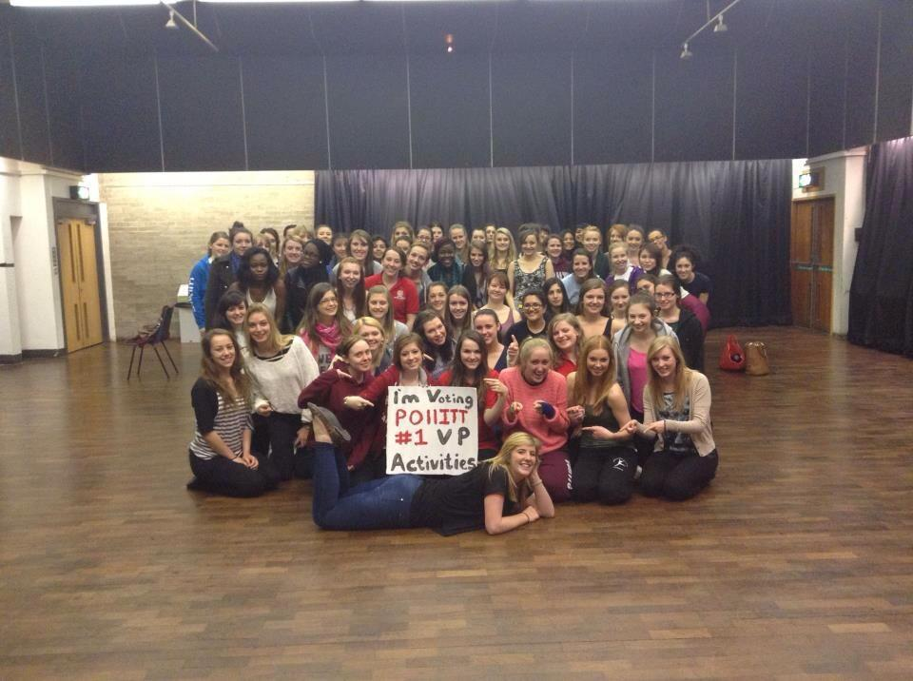
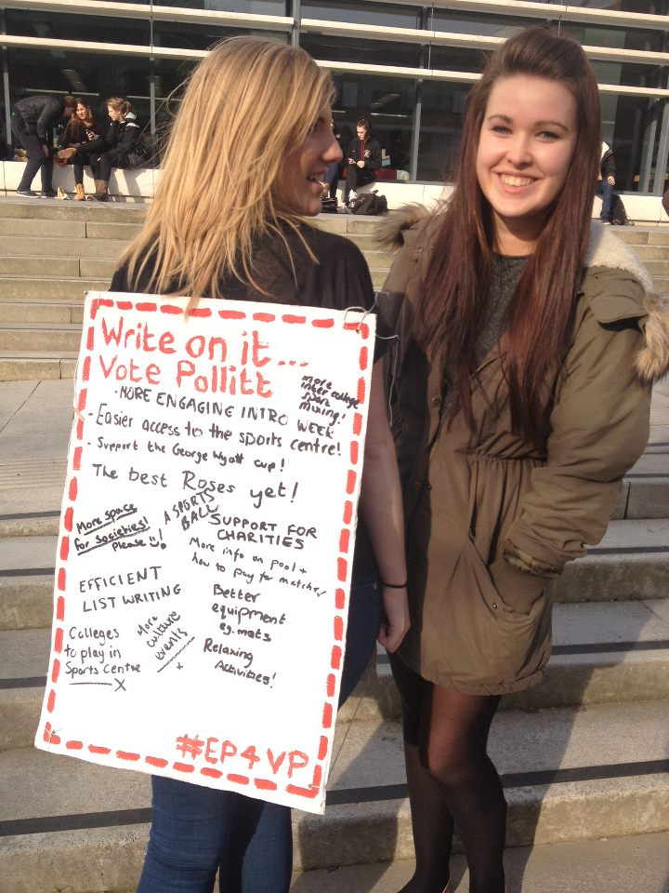
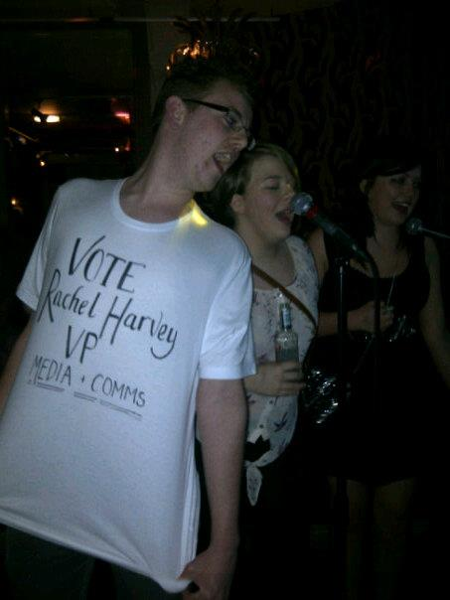
Go out and talk to people

Slide 9
Standing out

